Slide 1

Data science job Analysis
Sudhanthiralakshmi M
7229

Slide 2
Steps involved in Analysis process:
Explore every feature in the dataset
Work Year Analysis
Experience Level Analysis
Company Location Analysis
Salary Analysis

Slide 3
Description about Datasets
Work_year: The year the salary was paid
Experience_level: The experience level in the job during the year with the following possible values: EN = Entry-level / Junior; MI = Mid-level / Intermediate; SE = Senior-level / Expert; EX = Executive-level / Director
Employment_type: The type of employement for the role: PT = Part-time; FT = Full- time; CT Contract; FL = Freelance
Job_title: The role worked during the year.
Salary: The total gross salary amount paid.
Salary_currency: The currency of the salary paid as an ISO 4217 currency code.
Salary_in_usd: The salary in USD (FX rate divided by avg. USD rate for the resp year
Employee_residence: Employee's primary country of residence in during the work year as an ISO 3166 country code(Alpha-2 code).
Remote_ratio: The overall amount of work done remotely, possible values are as follows: 0 = No remote work (less than 20%); 50 = Partially remote; 100 = Fully remote (more than 80%)
Company_location: The country of the employer's main office or contracting branch
Company_size: The average number of people that worked for the company during the year: S = less than 50 employees (small); M = 50 to 250 employees (medium); L = more than 250 employees (large)

Slide 4
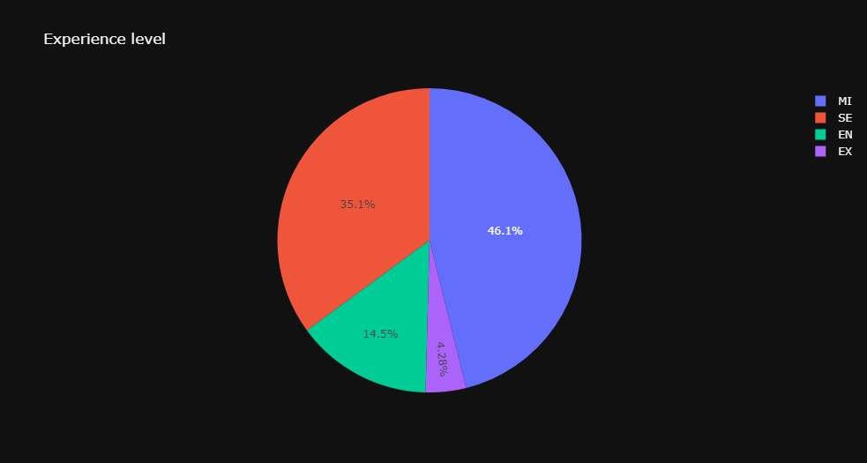
Analysis based on Experience
MI - Mid level
SE - Senior Executive
EN - Entry Level
EX - Executive
Insights: Most of the employees are mid-level and senior executives,So it is very rare to get a job in datascience as entry level

Slide 5
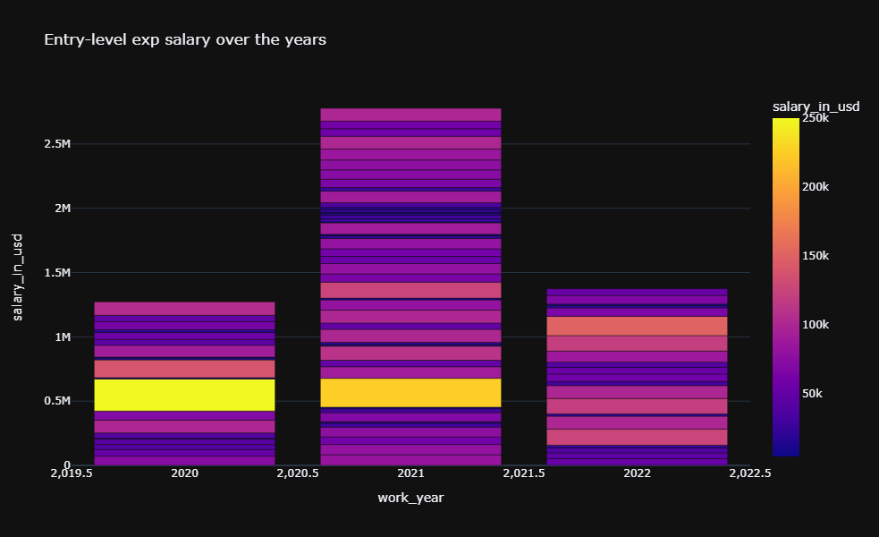
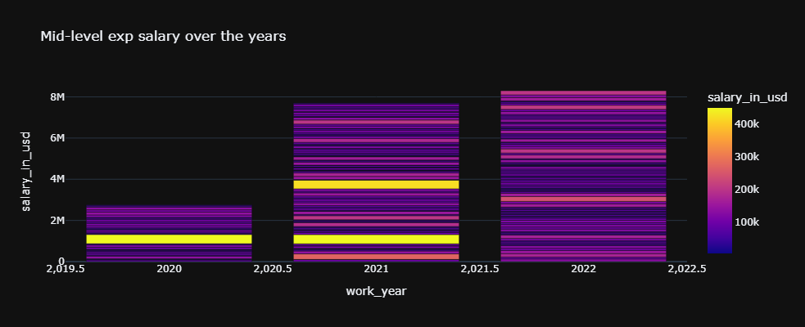
Analysis of salaries based on Experiences related to work year
Here we have compared the salary for entry level and mid level experiences based on the Work years

Slide 6
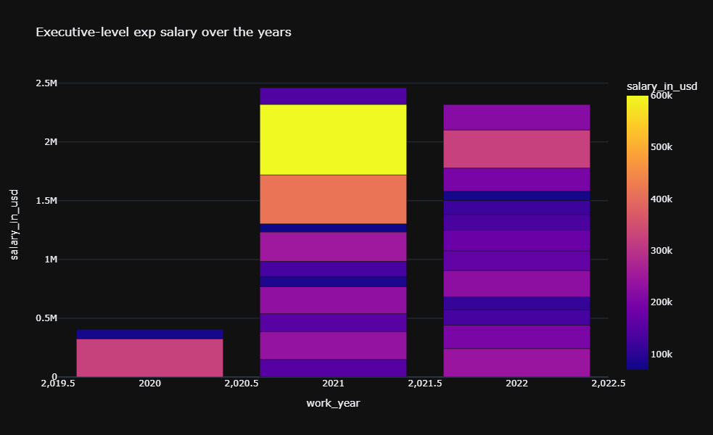
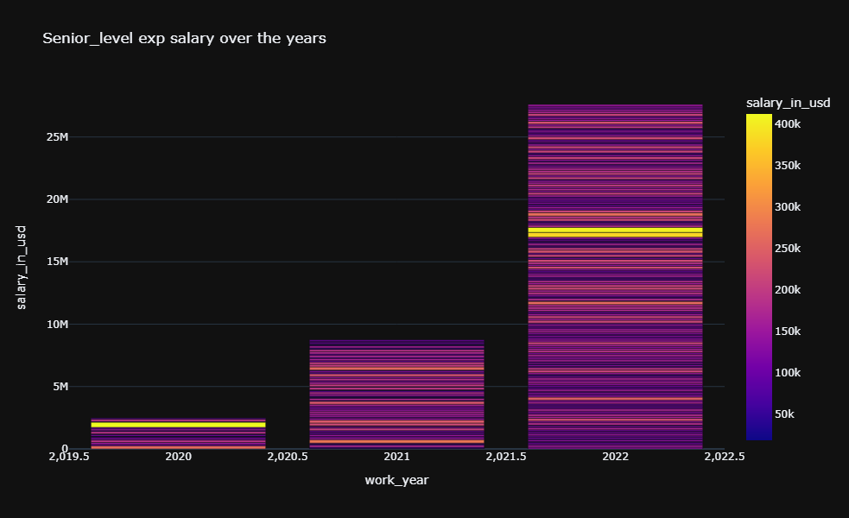
Analysis of salaries based on Experiences related to work year
Here we have compared the salary of Senior level and Executive level experiences based on the Work years
Insights: With these above four graphs we can cleary understood the salaries differences and raises between experience levels over the few years

Slide 7
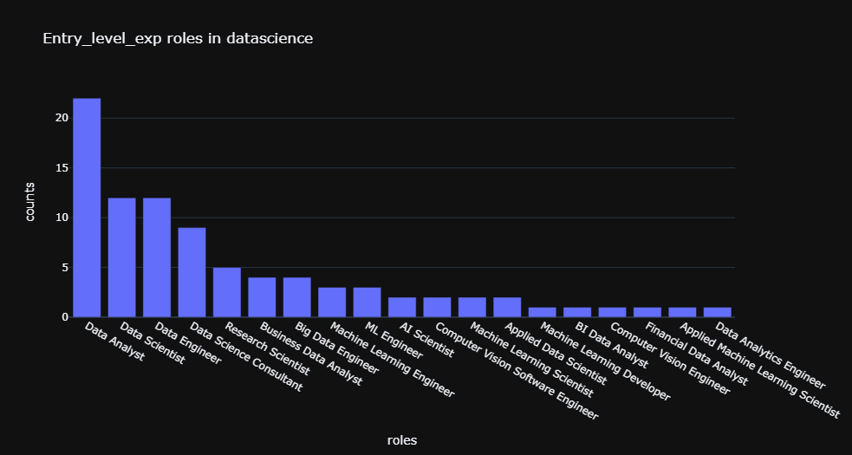
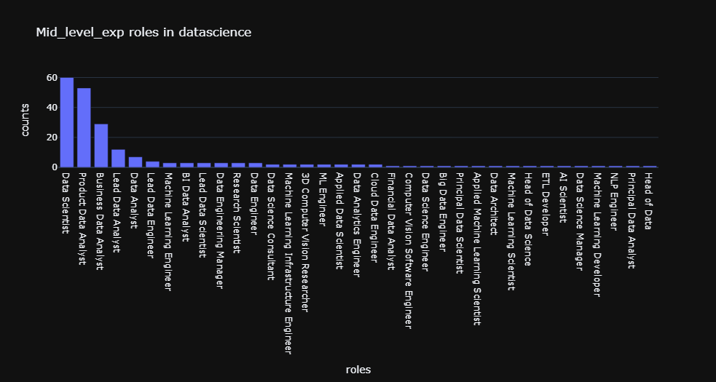
Comparison Based on Job roles and their experiences

Slide 8
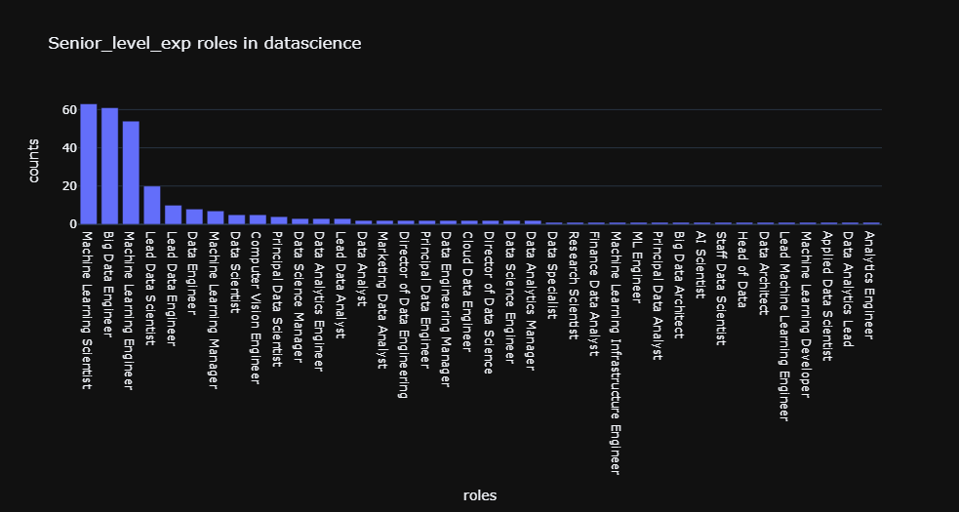
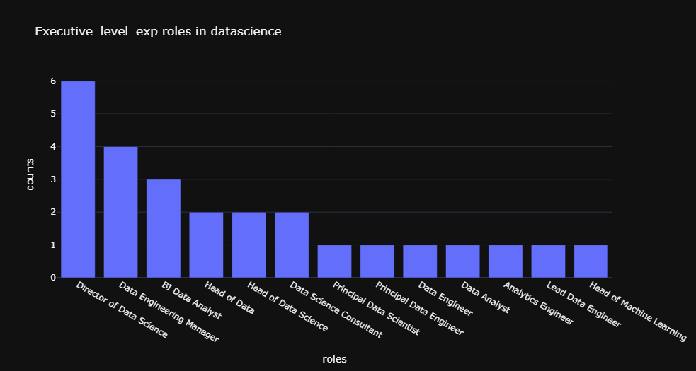
Comparison Based on Job roles and their experiences
Insights: We can see that most of the popular roles are Datascientist,Machine learning scientist,Data analyst across experience wise

Slide 9
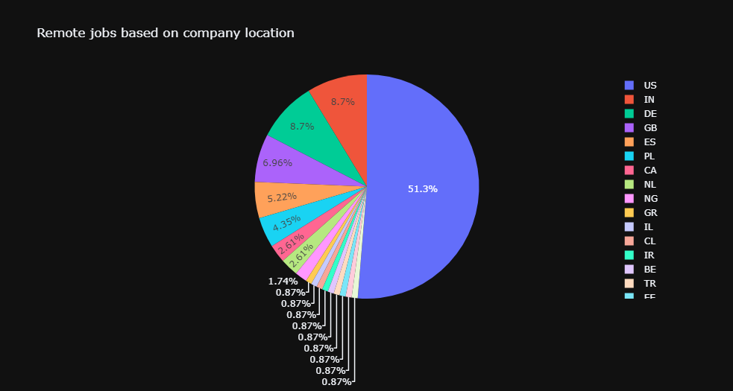
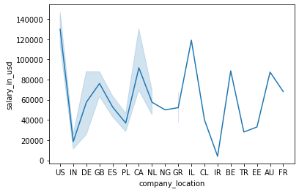
Plots to identify remote jobs based on company location
Around 51 % company based on US are offering remote jobs for datascience!
US based remote companies offering more dollars for datascience domains

Slide 10
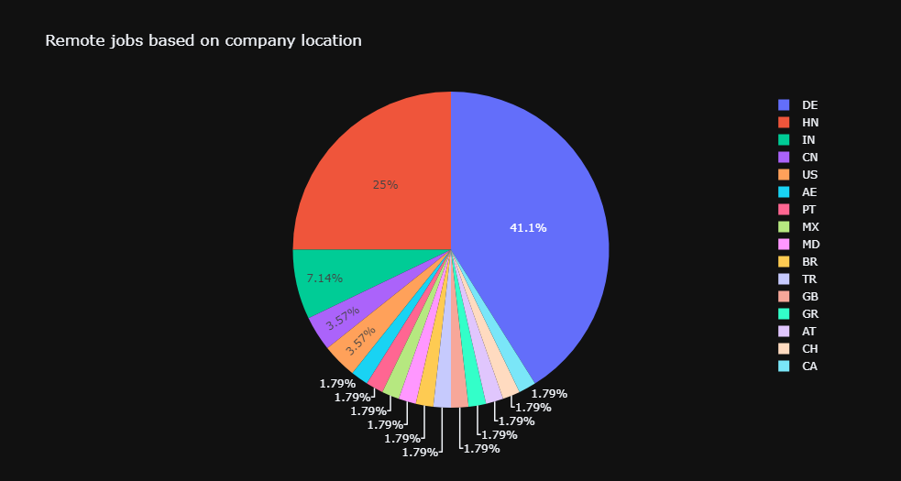
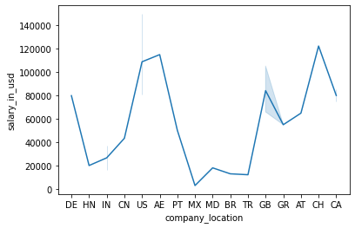
Non Remote jobs based on location
Insights: German based companies are mostly not offering remote jobs,So the candidates have to think before applying for a job in germany.
German based companies are offering non_remote jobs,But Giving less dollars compared to US,So choosing US market for remote and non_remote datascience jobs is a best decision

Slide 11
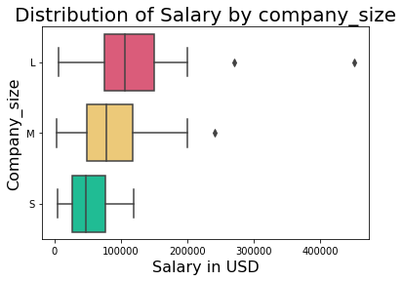
Distribution of salary visualized using boxplot
Insights: Large enterprises in remote offerring more salary for datascience roles,So if you're decided to go remote you should apply for large companies for salary parameters.

Slide 12
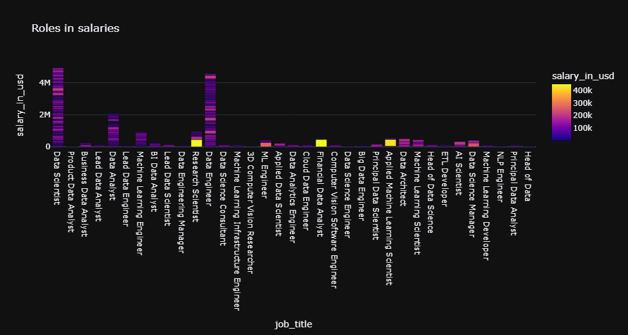
Analysis of salaries based on the roles
Insights: Datascientist and data engineer have demand,But Research scientist,Financial analyst and Applied ML scientist has low demand relatively paying good compared to above two!

Slide 13
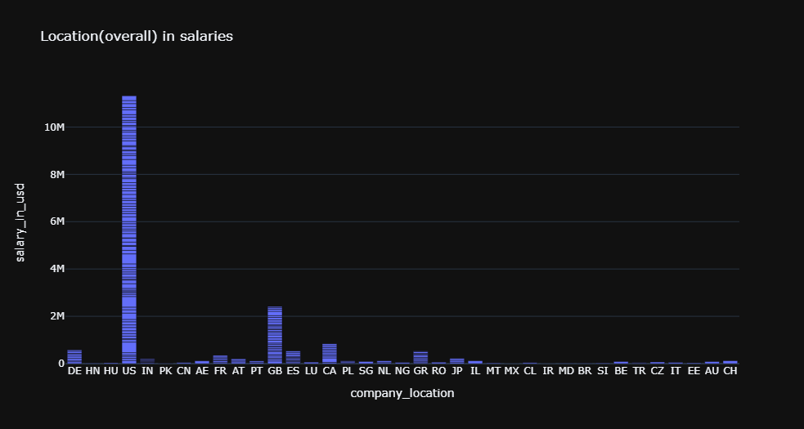
Analysis of overall salaries based on location
Insights: US is giving high paying jobs compared to all other countries

Slide 14
Machine learning
Here we have used two algorithms for prediction of salaries based on location
Decision Tree
They provide a highly effective structure within which you can lay out options and investigate the possible outcomes of choosing those options.
Accuracy : 0.71875
Insight : Using this algorithm we can able to predict the salary based on location with
72% Accuracy
Logistic regression
Logistic regression is a statistical analysis method to predict a binary outcome, such as yes or no, based on prior observations of a data set.
Accuracy : 0.8125
Insight : Using this algorithm we can able to predict the salary based on location with
82% Accuracy

Slide 15
Thank you…
….

